Slide 1

Emergent Technology in Environmental Science
GEOLOGICAL SCIENCES
College of Science
University of Texas at El Paso
Geological Science Department
Esenam Ziwu – Masters Research Student
Julio Ceniceros – Masters Research Student

Slide 2
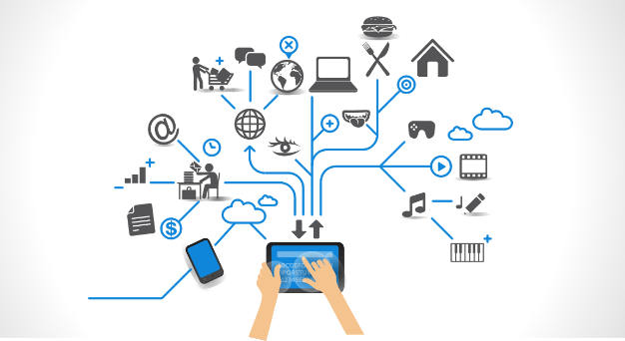
Introduction
We have assessed the current and future state of technology within our discipline and considered how it relates to our own individual research topics.
We will discuss the following four sections:
Data Management & Collection
Data Integration and Analysis
Workflow Systems
Visualization

Slide 3

Data Management & Collection
Data Management – A process by which the required data is gathered, validated, stored, protected, and processed. This creates accessibility, reliability, and timeliness for users.
Data Collection - Data collection is the process of gathering and measuring information on targeted variables in an established systematic fashion.

Slide 4
Continued
1) Existing technology
The Community Research & Development Information Service (CORDIS)
Predicting individual exposure to ambient air pollution.
2) Citizen Data
Third-Wave Data Project; China (2011-2020)
Chinese citizens use air filters in their homes which also collect data and are connected to the internet.
120 Air quality stations were combined with the citizen data.
“Air Quality Doctor” mobile app. https://www.tzoa.com/#homepage
3) Sensor Networks
TetraScience
Developed a gadget is to enhance experimental workflow, lab monitoring and instrument utilization.

Slide 5
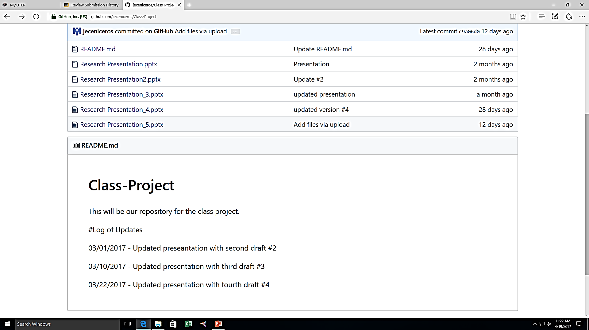
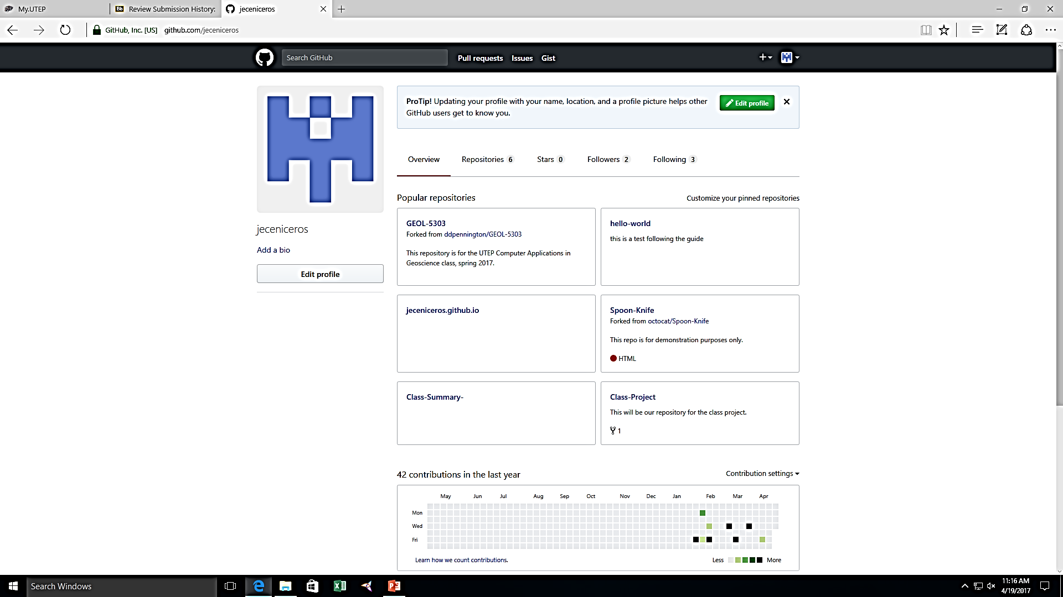
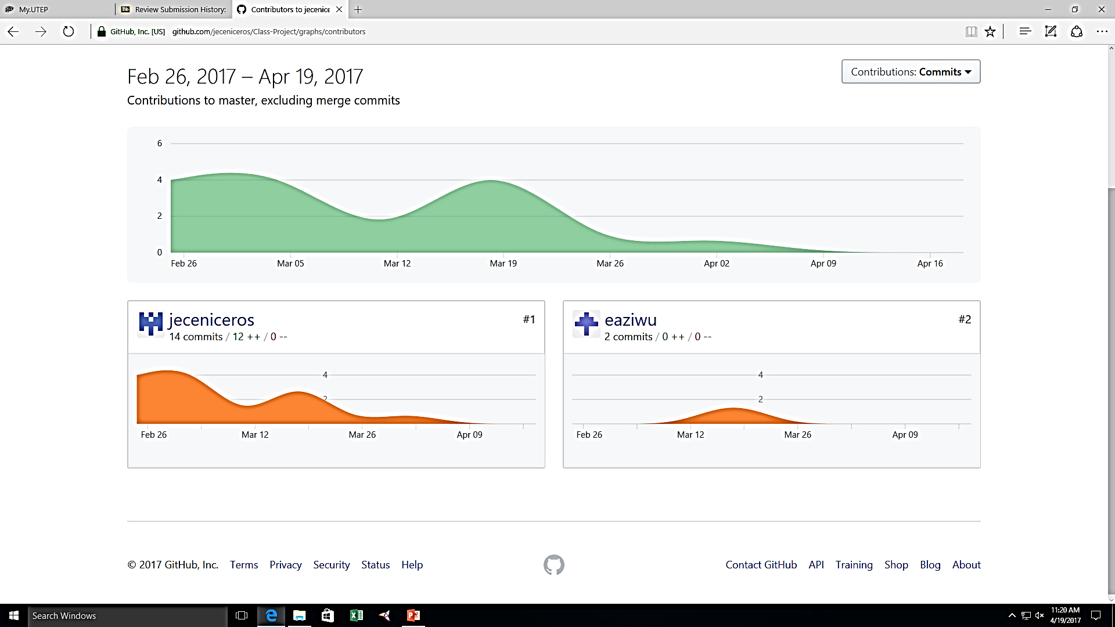
GitHub Example

Slide 6
Data Integration and Analysis
Data Integration - involves combining data from various sources and providing users with a unified view of these data. This process becomes extremely useful when it crosses various domains and disciplines and can generate new data from the data links.
Analysis of Data - is a process of examining, transforming, and visualizing data with the goal of discovering useful information to support results and decision-making.

Slide 7
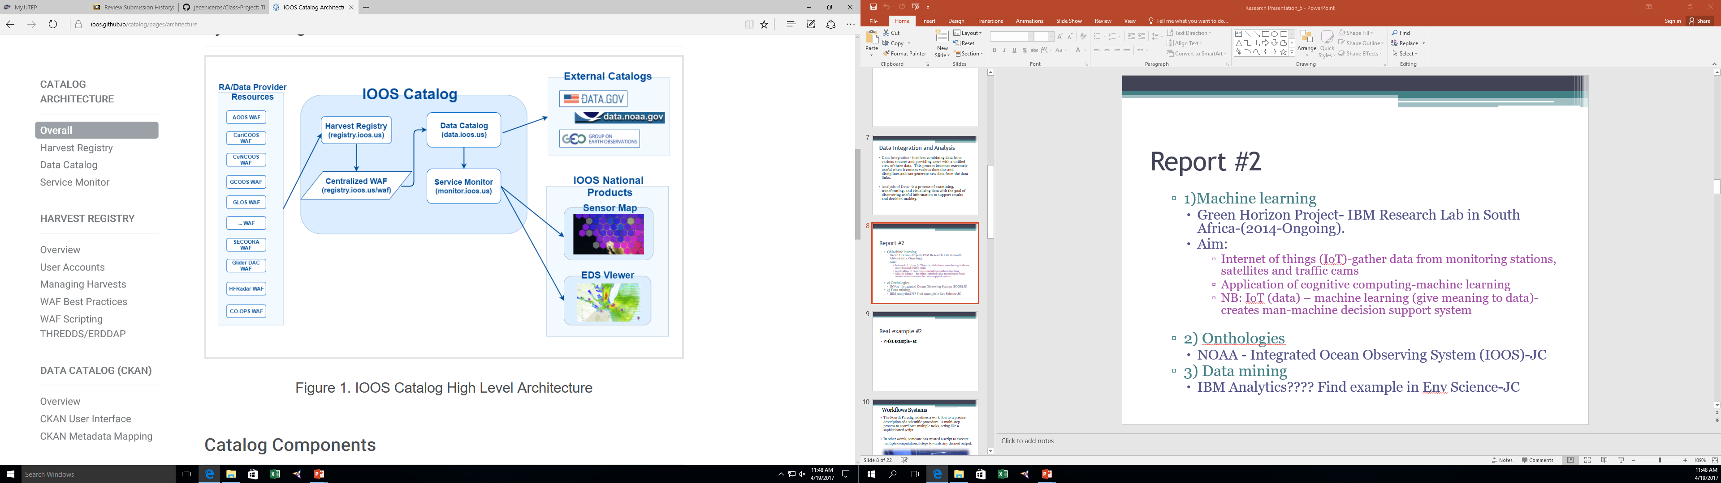
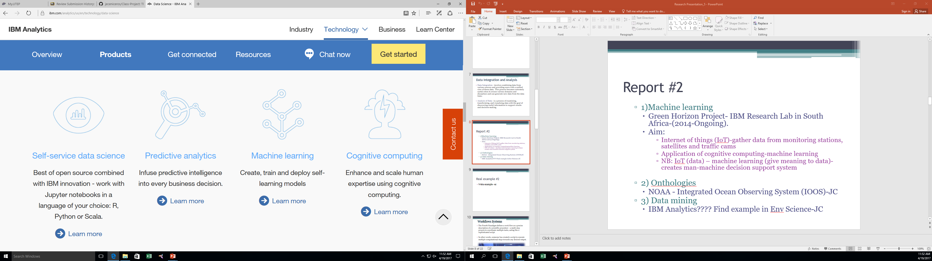
Continued
Man-Machine Support System
O₃
1) Machine Learning
IBM Research Lab in South Africa
2) Ontologies
NOAA - Integrated Ocean Observing System (IOOS)
3) Data mining
IBM Analytics
IoT
Machine Learning

Slide 8
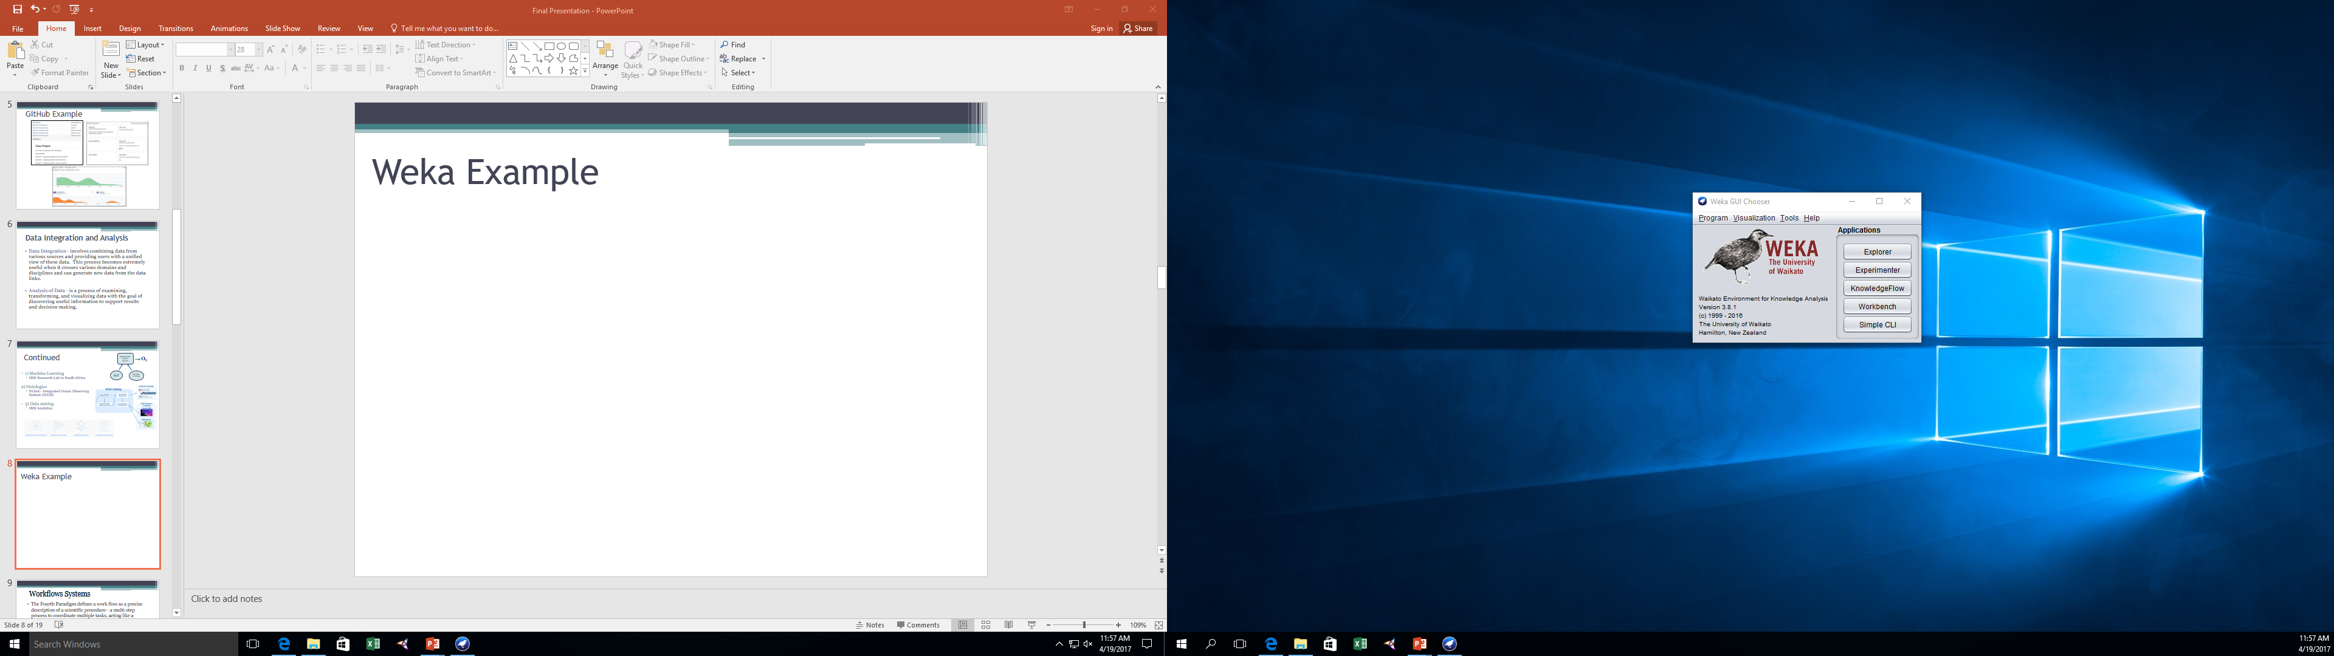
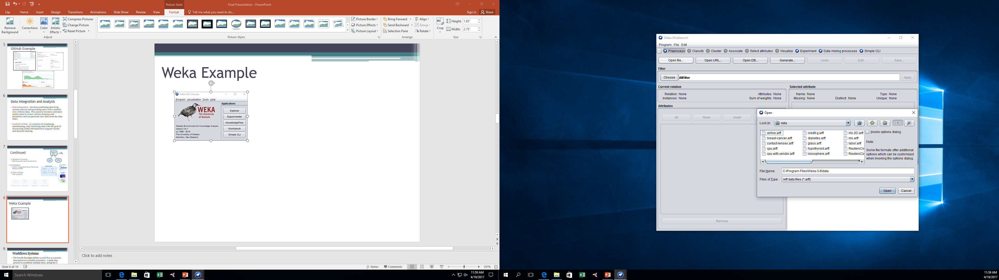
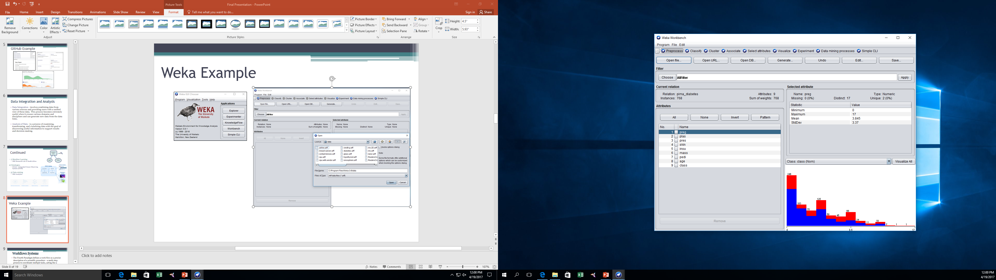
Weka Example

Slide 9

Workflows Systems
The Fourth Paradigm defines a work flow as a precise description of a scientific procedure – a multi-step process to coordinate multiple tasks, acting like a sophisticated script.
In other words, someone has created a script to execute multiple computational steps towards any desired output.

Slide 10
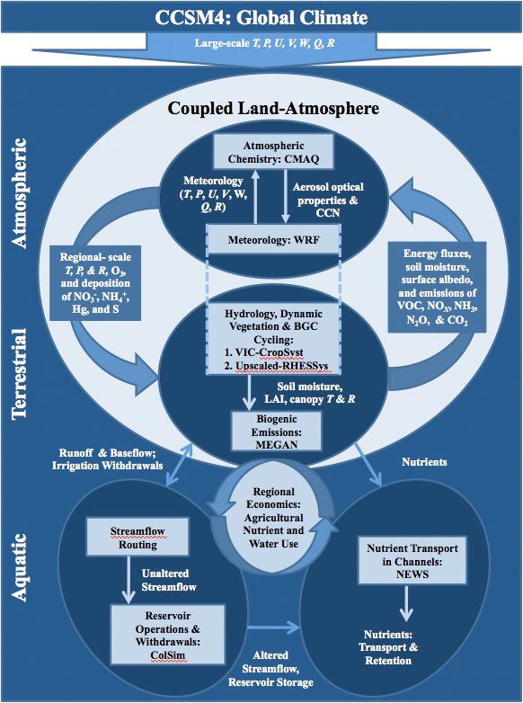
Continued
Heterogeneous Code
BioEarth
Provenance
The Accelerated Climate Modeling for Energy (ACME)
Programing climate models via workflows.
Health Application
The PRISM Project
BRANCHES
Sensor Develop.
Informatics
Data Coordination Center
BREATHE Platform
Taverna
UIMA

Slide 11
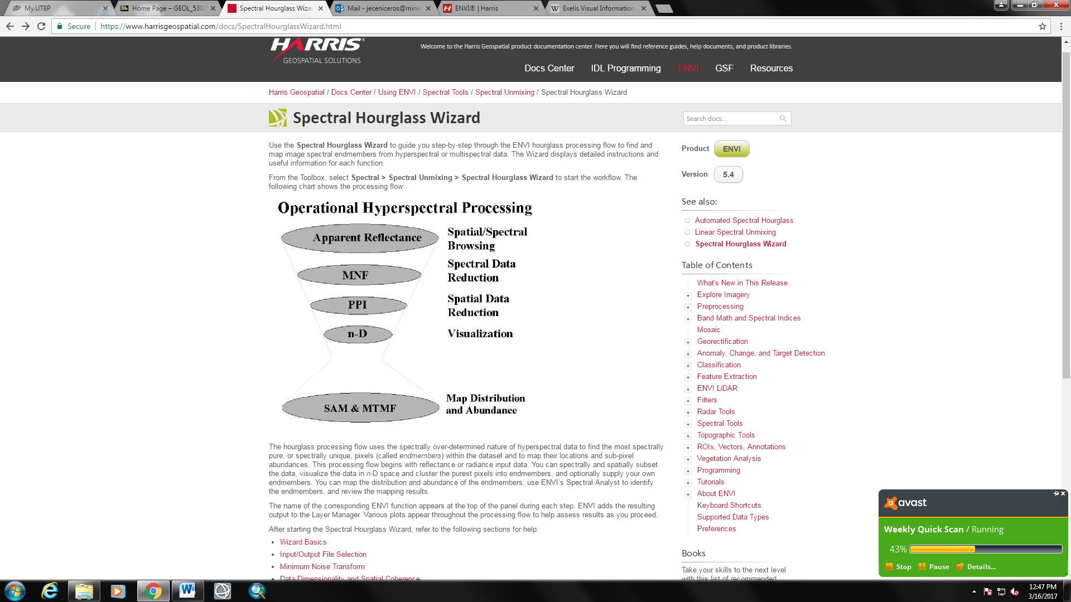
ENVI Example
ENVI has a tool called the Spectral Hourglass Wizard. This workflow allows the user to find and map image spectral endmembers from hyperspectral or multispectral data.
Calibrate Data in Matlab
Process in Spectral Hourglass Wizard
Generate New Endmembers
Visualize Selected Endmebers
MODIS Relfectance Data
Identify Endmembers
Export Reflectance Data in HDF Format
Export Map

Slide 12
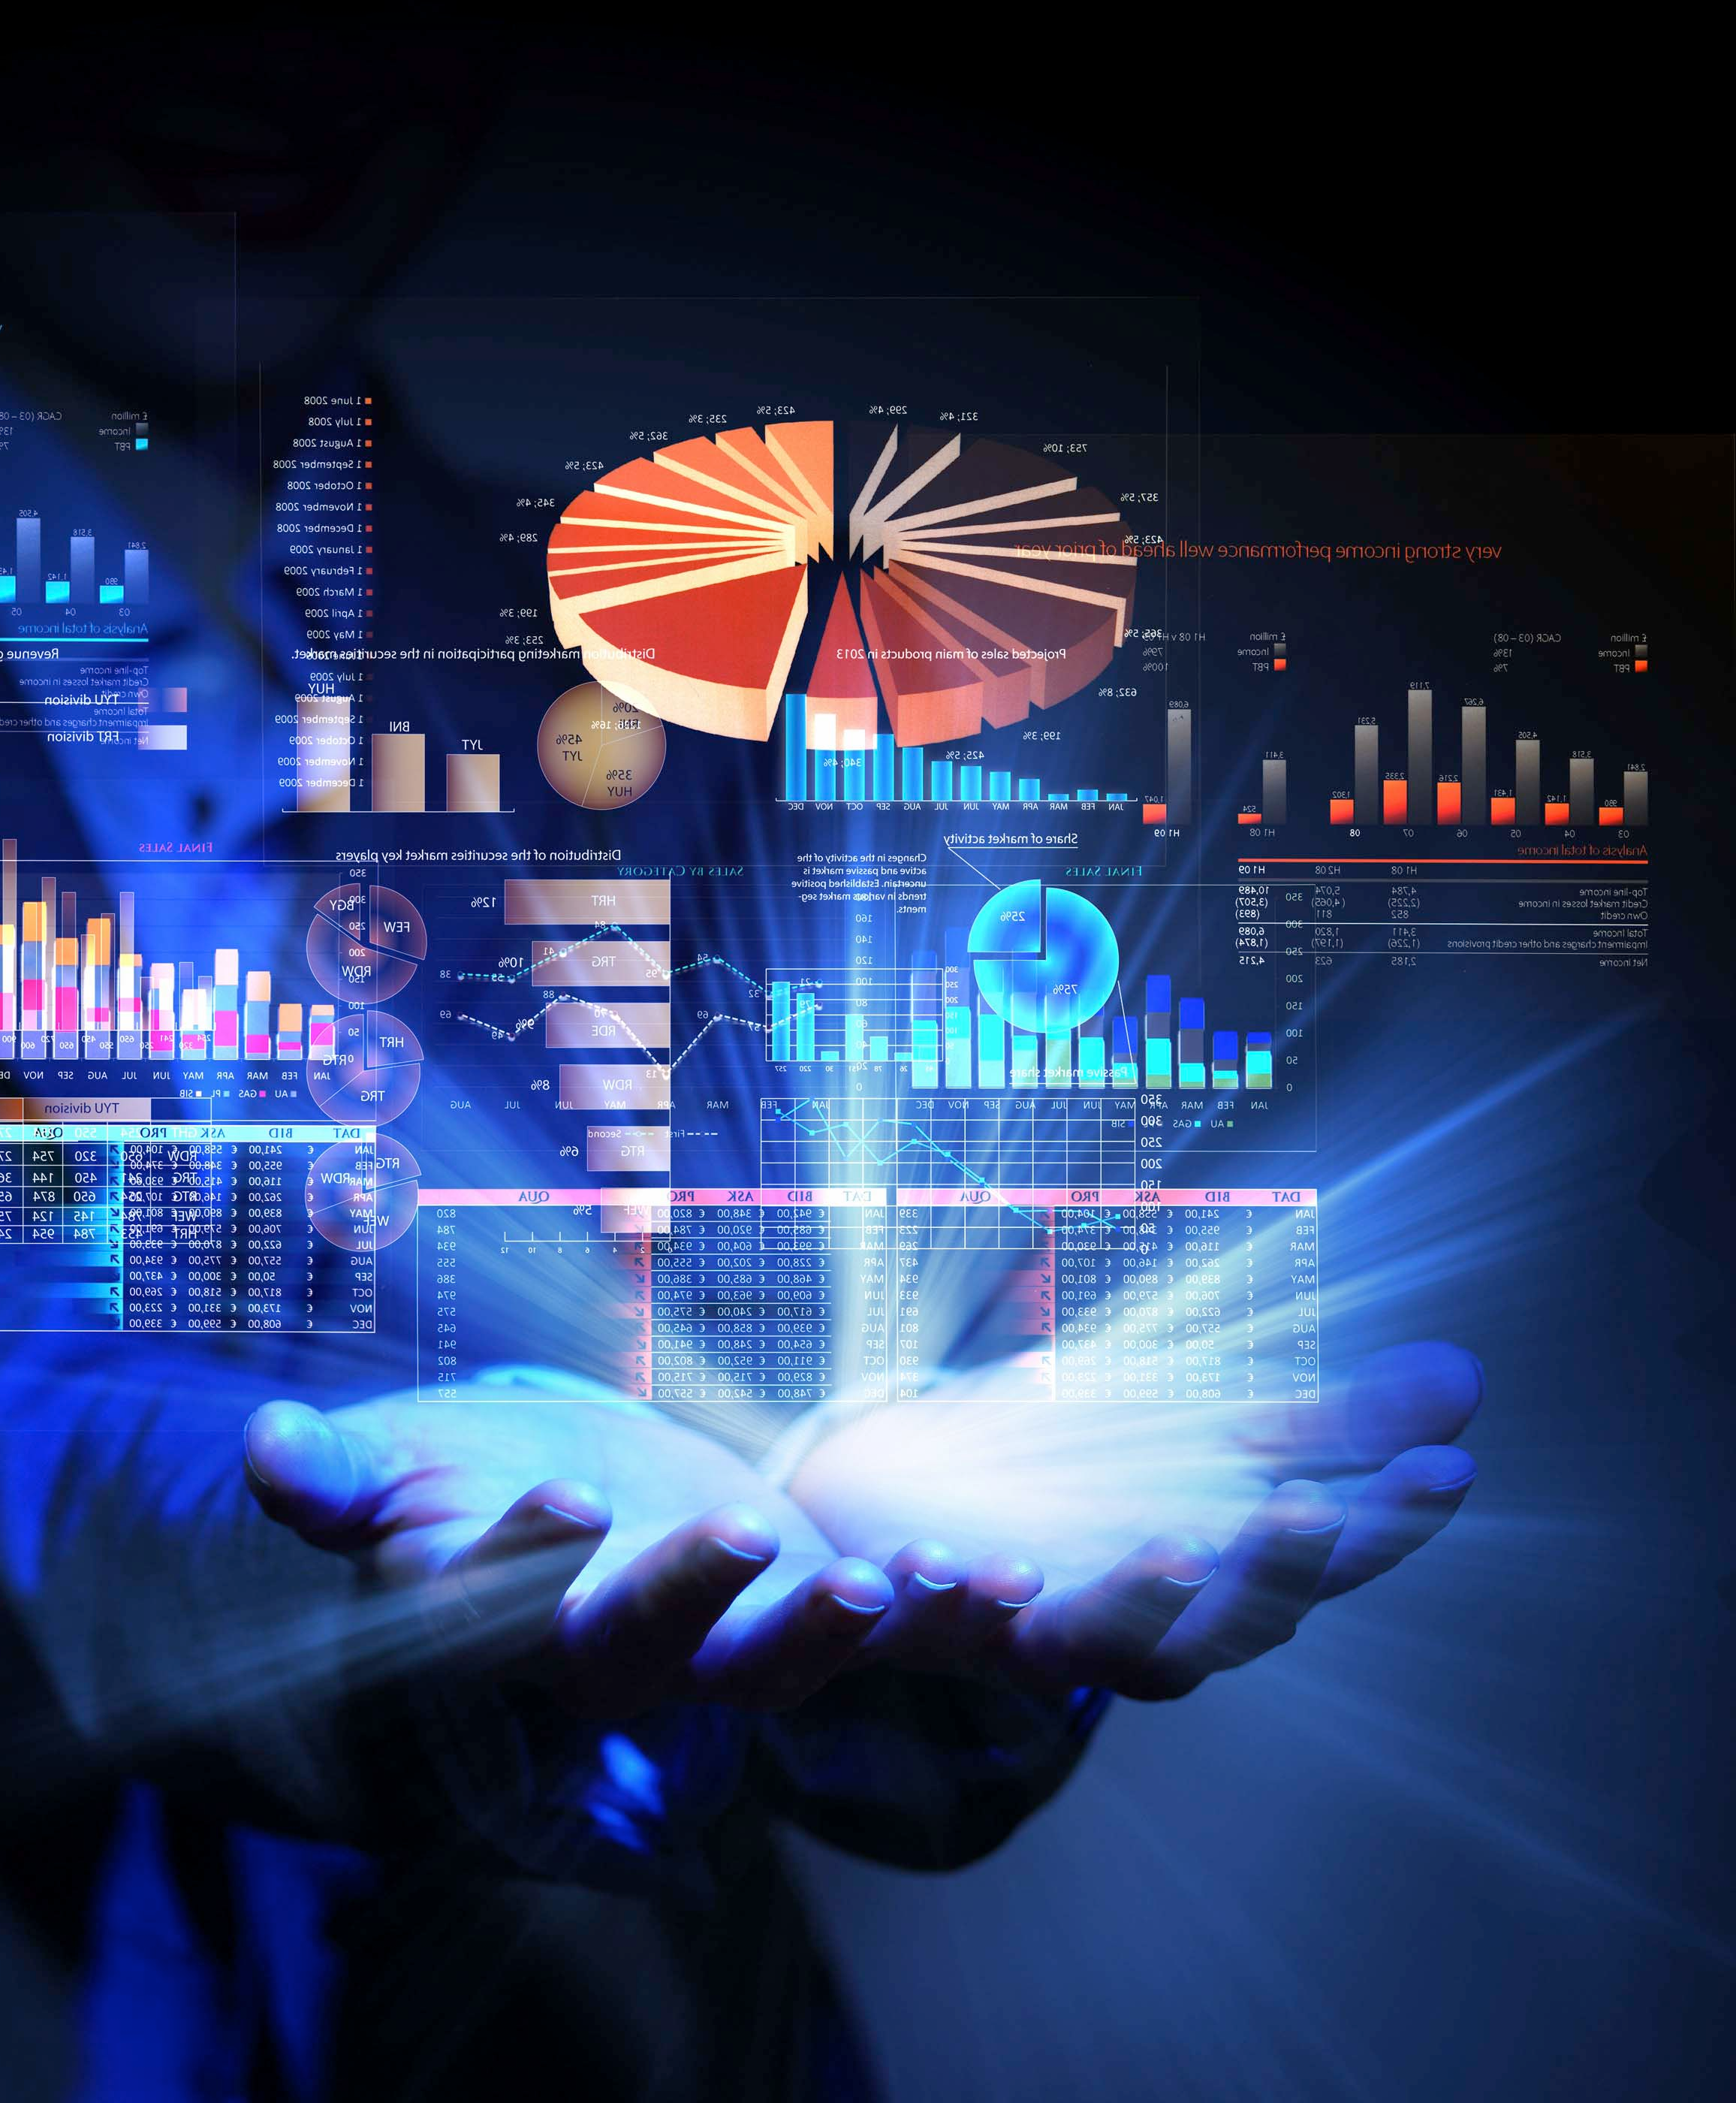
Visualization
Scientific visualization is when someone creates a representation of their data in a visual format.
Visualization can validate new models, provide comparison between models and datasets, enables quantitative and qualitative querying, improves interpretation of data, and facilitates decision making.

Slide 13
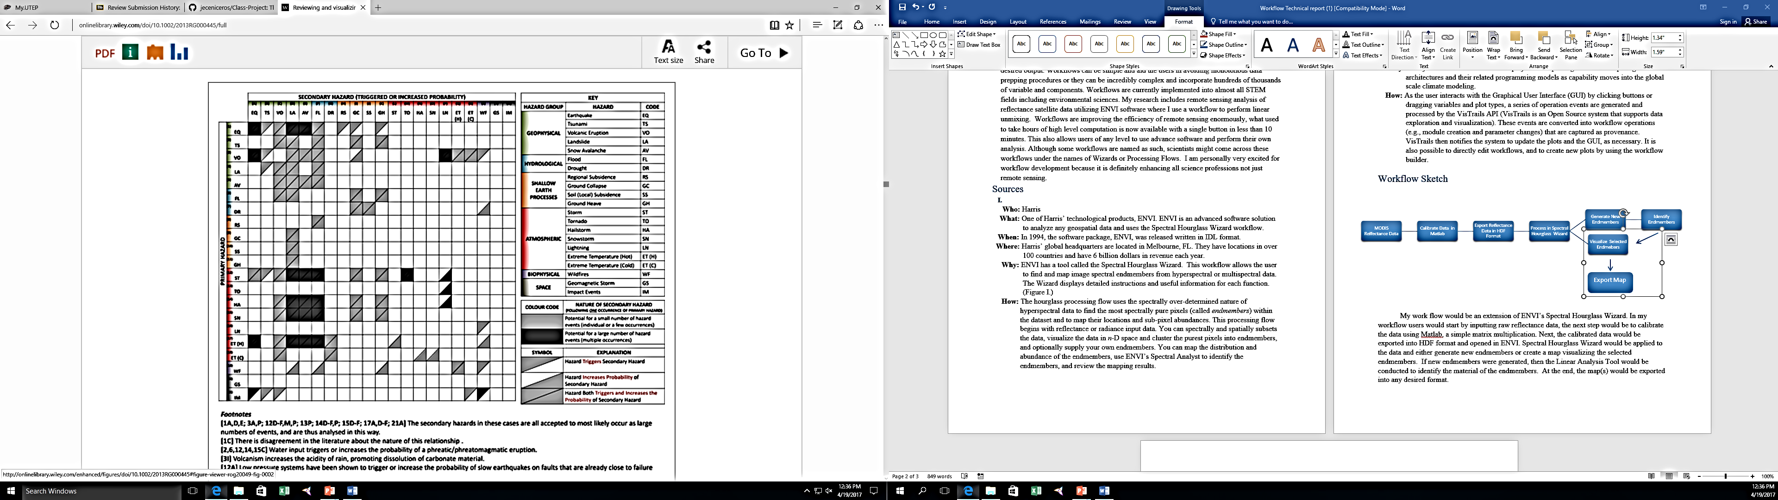
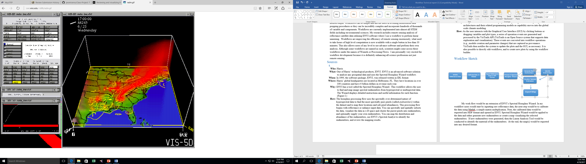
Continued
Super Computing
The Texas Advanced Computing Center (TACC) at the University of Texas at Austin.
Visualization Frameworks
Reviewing and visualizing the interactions of natural hazards.
Visualization 3D Software
SSEC Visualization Project (Vis5D System)

Slide 14
Relevance
Data Management & Collection – BIG data in our field is constantly created and stored.
Data Integration and Analysis – Integration must be considered to solve large dynamic problems.
Workflow Systems – Workflows allow for real time analysis on environmental conditions.
Visualization – Detection and validation of work while enabling unexpected discoveries.

Slide 15


Conclusion
Scientist today are accumulating new data at a rate that exceeds their capacity to extract value from it. The question facing every organization that wants to attract a community is how to use data effectively — not just their own data, but all of the data that's available and relevant.

Slide 16
Questions?

Slide 17
Citations
Accelerated Climate Modeling For Energy. (N.D.). Retrieved March 16, 2017, From Https://Climatemodeling.Science.Energy.Gov/Projects/Accelerated-climate-modeling-energy
"Earth Observing Laboratory | Earth Observing Laboratory." Earth Observing Laboratory | Earth Observing Laboratory. N.P., N.D.Web. 12 Feb. 2017.
Gill, J. C., And B. D. Malamud (2014), Reviewing And Visualizing The Interactions Of Natural hazards, Rev. Geophys.,52,doi:10.1002/2013rg000445
Hey, T., Tansley, S., & Tolle, K. (2009). The Fourth Paradigm: Data-intensive Scientific Discovery. Microsoft Research. Retrieved Fromhttps://Www.Microsoft.Com/Enus/Research/Publication/Fourth-Paradigm-data-intensive- scientific-discovery/
Hsu, A., Weinfurter, A., Yan, C., And Cheng,y. (2017) From Citizens To Satellites: Third-wave Data Approaches In China
Ibm Analytics. (2016, March 17). Retrieved March 04, 2017, Fromhttp://Www.Ibm.Com/Analytics/Us/En/
Integrated Ocean Observing System. (N.D.). Retrieved March 04, 2017, Fromhttps://Ioos.Noaa.Gov/
Mullis, T., Liu, M., Kalyanaraman, A., Vaughan, J., Tague, C., & Adam, J. (2014). Design And Implementation Of Kepler Workflows For Bioearth. Procedia Computer Science, 29, 1722-1732.
National Center For Biotechnology Information. (N.D.). Retrieved March 04, 2017, Fromhttps://Www.Ncbi.Nlm.Nih.Gov/
Spectral Hourglass Wizard (Using Envi) [Harris Geospatial Docs Center]. (N.D.). Retrievedmarch 16, 2017, From Https://Www.Harrisgeospatial.Com/Docs/Spectralhourglasswizard.Html
"Texas Advanced Computing Center." Systems Overview - Texas Advanced Computingcenter. Vice President Of Research, N.D. Web. 02 Apr. 2017.
Http://Spectrum.Ieee.Org/Energywise/Energy/Environment/Tackling-air-quality-Prediction-in-south-africa-with-machine- learning
Http://Grantome.Com/Grant/Nih/U54-eb022002-01-5021
Http://Grantome.Com/Grant/Nih/U54-eb022002-01
Http://Www.Ssec.Wisc.Edu/~Billh/Epa.Html

